Slide 1

Search Algorithms
Analysis of Algorithms
Prepared by
John Reif, Ph.D.

Slide 2
Search Algorithms
Binary Search: average case
Interpolation Search
Unbounded Search (Advanced material)

Slide 3
Readings
Reading Selection:
  CLR, Chapter 12

Slide 4
Binary Search Trees
(in sorted Table of) keys k₀, …, k_{n-1}
Binary Search Tree property:
at each node x
key (x) > key (y) ∀ y nodes on left
subtree of x
key (x) < key (z) ∀ z nodes on right
subtree of x

Slide 5
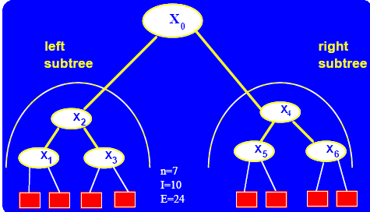
Binary Search Trees (cont’d)

Slide 6
Binary Search Trees (cont’d)
Assume
  Keys inserted into tree in random order
  Search with all keys equally likely
  length = # of edges
  n + 1 = number of leaves
Internal path length I
= sum of lengths of all internal paths of length > 1 (from root to nonleaves)

Slide 7
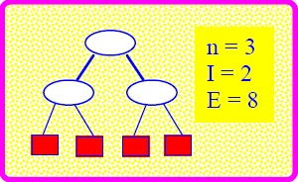
Binary Search Trees (cont’d)
External path length E
= sum of lengths of all external paths (from root to leaves) = I + 2n

Slide 8
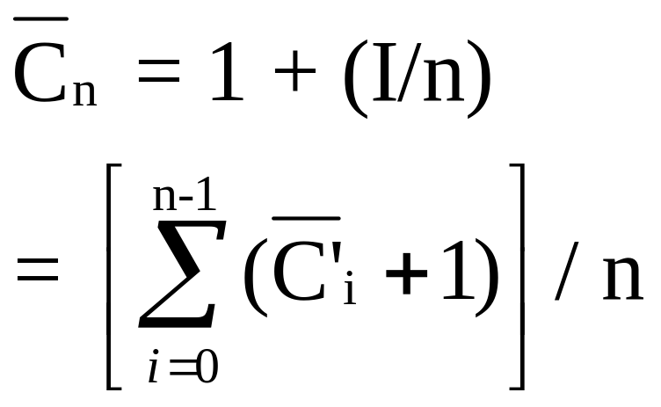
Successful Search
Expected # comparisons

Slide 9
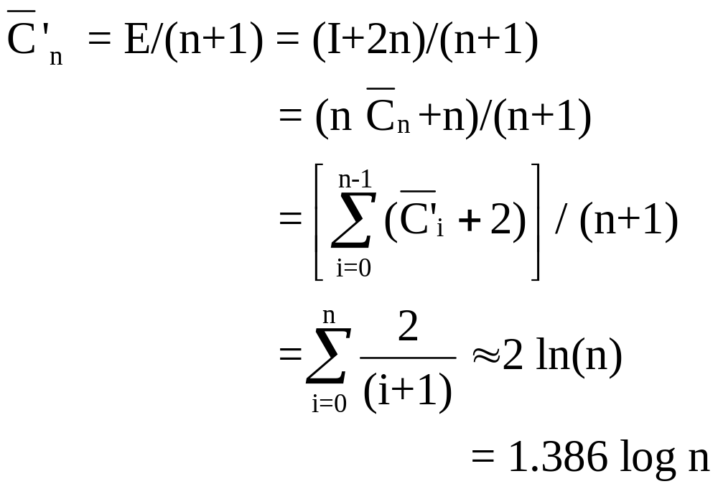
Unsuccessful Search
Expected # comparisons

Slide 10
Model of Random Real Inputs over an Interval
Input
  Set S of n keys each independently randomly chosen over real interval |L,U| for 0 < L < U
Operations
  Comparison operations
  ⎣ ⎦ , ⎡ ⎤ operations:
    ⎣r⎦ =largest integer below or equal to r
    ⎡r⎤ = smallest integer above of equal to r

Slide 11
Sorting and Selection with Random Real Inputs
Results
  Sorting in 0(n) expected time
  Selection in 0(loglogn) expected time

Slide 12
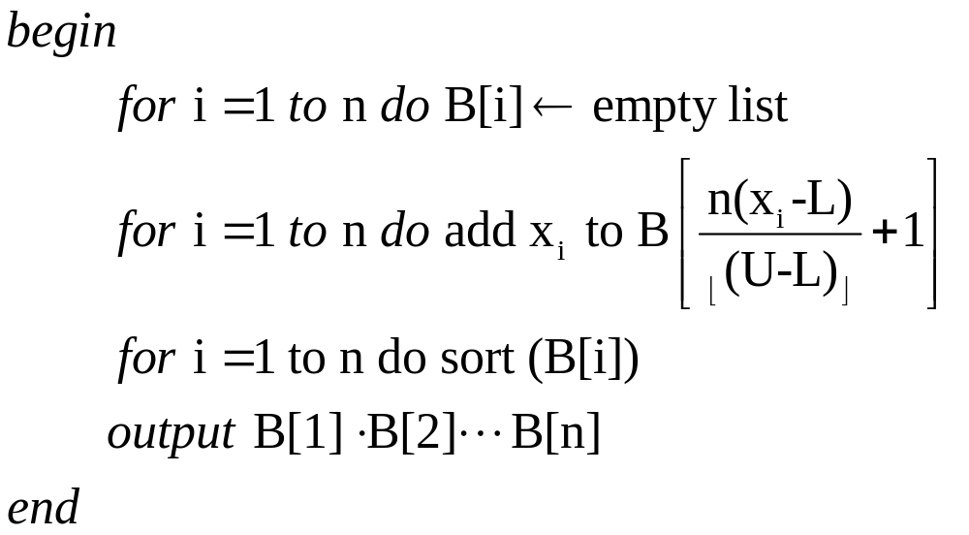
Bucket Sorting with Random Inputs
  Input set of n keys, S randomly chosen over [L,U]
Algorithm
BUCKEY-SORT(S):

Slide 13
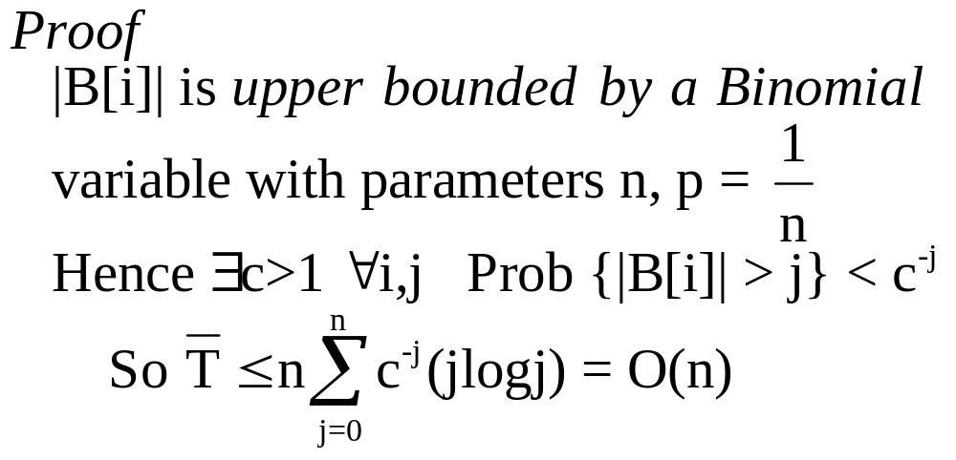
Bucket Sorting with Random Inputs (cont’d)
Theorem The expected time T of BUCKET-SORT is 0(n)
  Generalizes to case keys have nonuniform distribution

Slide 14
Random Search Table
Table X = (x₀ < x₁ < …< x_{n} < x_{n+1}) where x₁, …, x_{n} random reals chosen independently from real interval (x₀, x_{n+1})
Selection Problem
Input key Y
Problem find index k* with X_{k*} = Y
Note k* has Binomial distribution
with parameters
n,p = (Y-X₀)/(X_{n+1}-X₀)

Slide 15
Algorithm
PSEUDO INTERPOLATION-SEARCH (X,Y)
Random Table
X = (X₀ , X₁ , …, X_{n} , X_{n+1})
Algorithm
pseudo interpolation search (X,Y)
[0] k ← ⎡ pn⎤ where p = (Y-X₀)/(X_{n+1}-X₀)
[1] if Y = X_{k} then return k

Slide 16
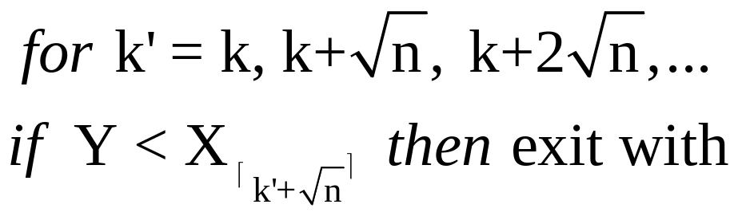
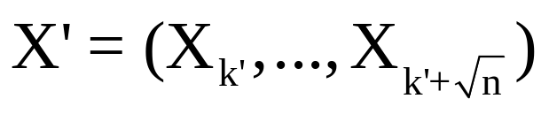
Algorithm PSEUDO INTERPOLATION-SEARCH (X,Y) (cont’d)
[2] If Y > X_{k} then
output pseudo interpolation search (X’,Y)
where

Slide 17
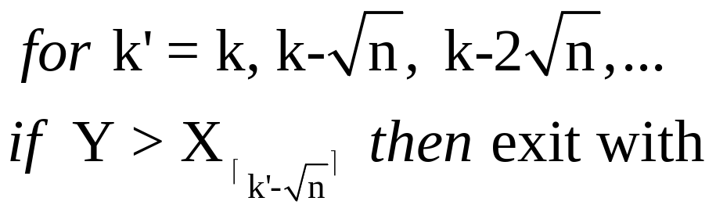
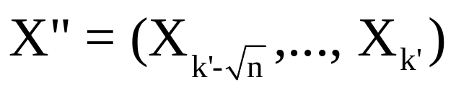
Algorithm PSEUDO INTERPOLATION-SEARCH (X,Y) (cont’d)
[3] Else if Y < X_{k} then
output pseudo interpolation search (X’,Y)
where

Slide 18
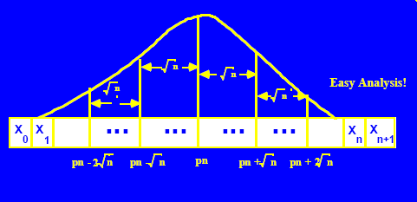
Probability Distribution of Pseudo Interpolation Search

Slide 19
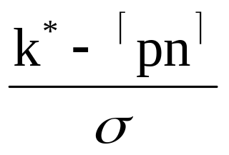
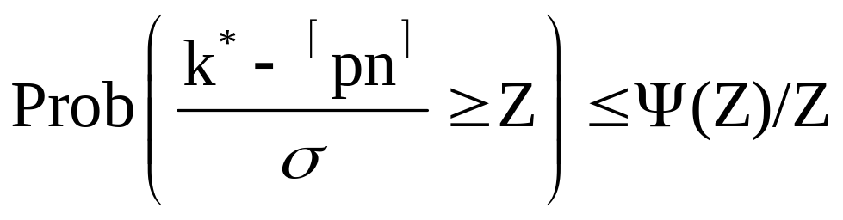
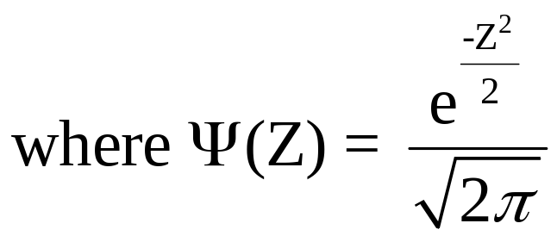
Probabilistic Analysis of Pseudo Interpolation Search
k* is Binomial with mean pn
variance σ² = p(1-p)n
So approximates normal as n → ∞
Hence

Slide 20
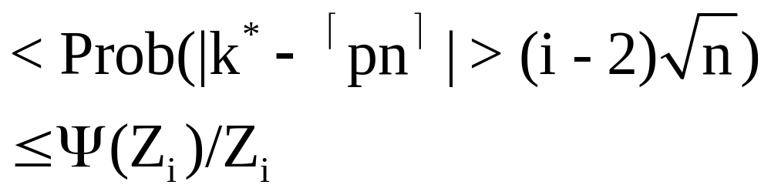
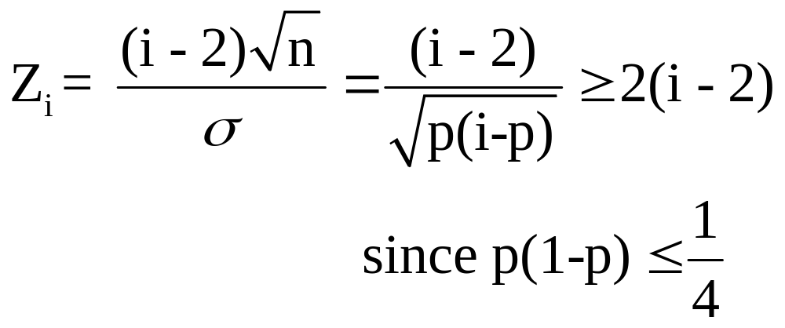
Probabilistic Analysis of Pseudo Interpolation Search (cont’d)
So Prob ( ≥ i probes used in given call)
where

Slide 21
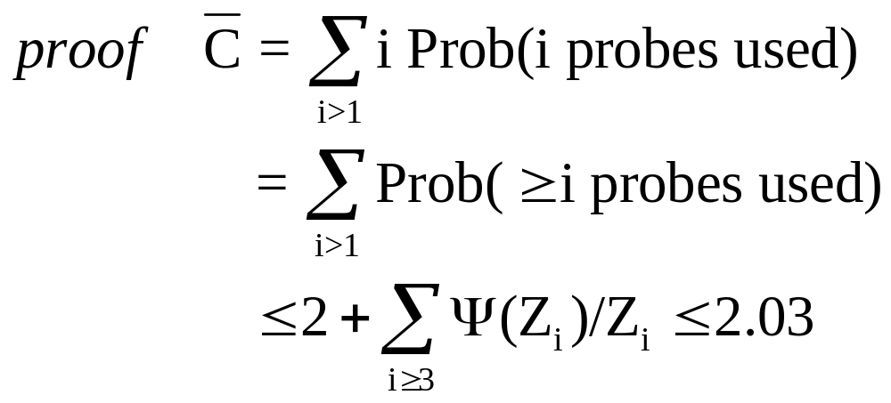
Probabilistic Analysis of Pseudo Interpolation Search (cont’d)
Lemma C ≤ 2.03 where
C = expected number of probes
in given call

Slide 22
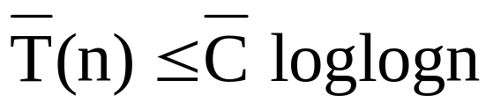
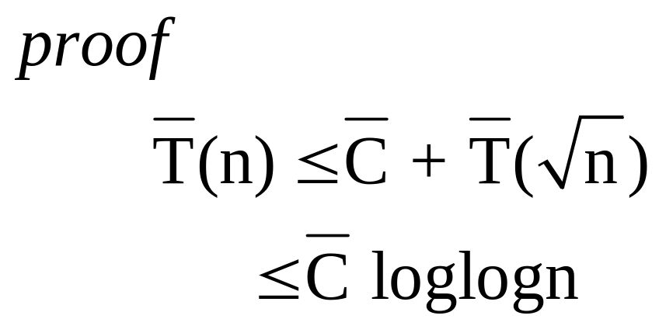
Probabilistic Analysis of Pseudo Interpolation Search (cont’d)
Theorem
  Pseudo Interpolation Search
has expected time

Slide 23
Algorithm
INTERPOLATION-SEARCH (X,Y)
Initialize k ← ⎡ np⎤ comment k = ⎡ E(k*)⎤
If X_{k} = Y then return k
If X_{k} < Y then
  output INTERPOLATION-SEARCH (X’,Y) where X’ = (x_{k,} …, x_{n+1} )
Else X_{k} > Y and
  output INTERPOLATION-SEARCH (X”,Y) where X” = (x_{0,} …, x_{k} )

Slide 24
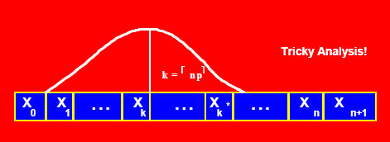
Probability Distribution of
INTERPOLATION-SEARCH (X,Y)

Slide 25
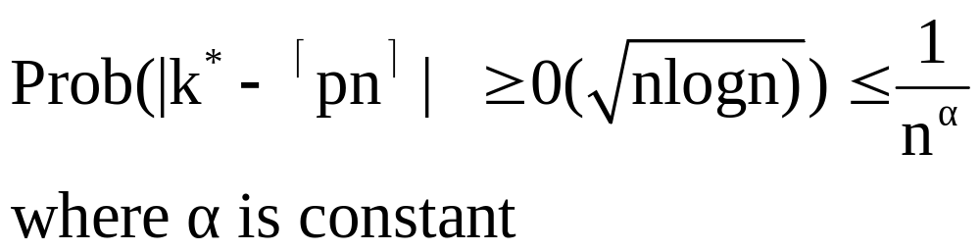
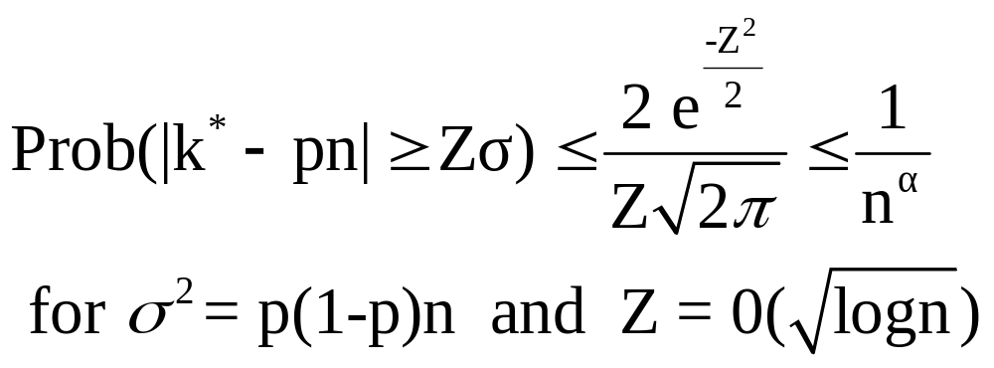
Advanced Material: Probabilistic Analysis of Interpolation Search
Lemma
Proof
  Since k* is Binomial with parameters p,n

Slide 26
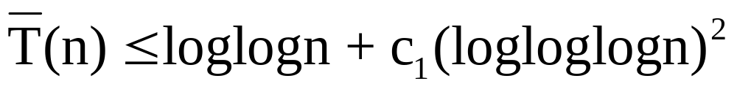
Probabilistic Analysis of Interpolation Search (cont’d)
Theorem
  The expected number of comparisons of Interpolation Search is

Slide 27
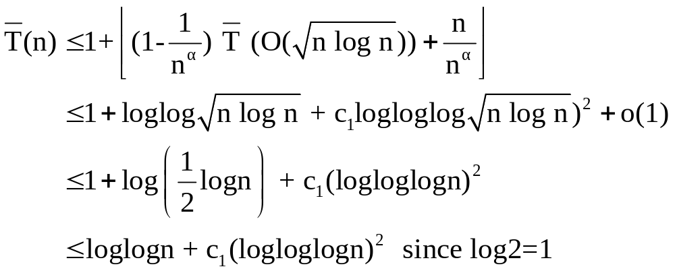
Probabilistic Analysis of Interpolation Search (cont’d)
Proof

Slide 28
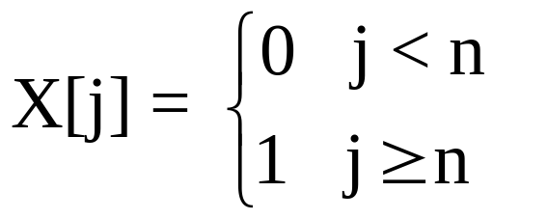
Advance Material:
Unbounded Search
Input table X[1], X[2], …
where for j = 1, 2, …
Unbounded Search Problem
  Find n such that X[n-1] = 0 and X[n]=1
Cost for algorithm A:
  C_{A}(n)=m if algorithm A uses m evaluations to determine that n is the solution to the unbounded search problem

Slide 29
Applications of Unbounded Search
Table Look-up in an ordered, infinite table
Binary encoding of integers
if S_{n} represents integer n,
then S_{n} is not a prefix of any S_{j} for n ≠ j
{S₁, S₂, …} called a prefix set
Idea: use S_{n} (b₁, b₂, …, b_{CA(n)})
where b_{m} = 1
if the m’th evaluation of X is 1
in algorithm A for unbounded search

Slide 30
Unary Unbounded Search Algorithm
Algorithm B₀
  Try X[1], X[2], …, until X[n] = 1
  Cost C_{B0}(n) = n

Slide 31
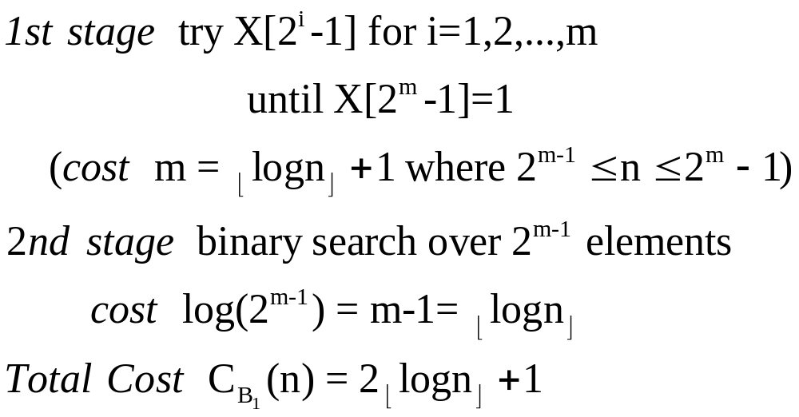
Binary Unbounded Search Algorithm
Algorithm B₁

Slide 32
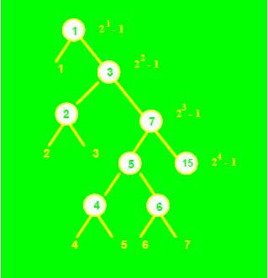
Binary Unbounded Search Algorithm (cont’d)

Slide 33
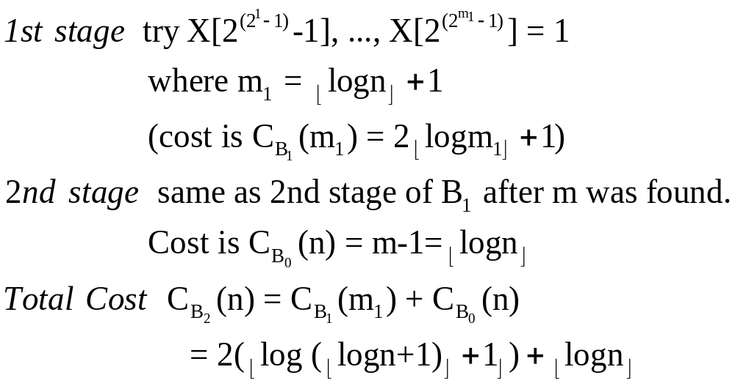
Double Unbounded Search Search
Algorithm B₂

Slide 34
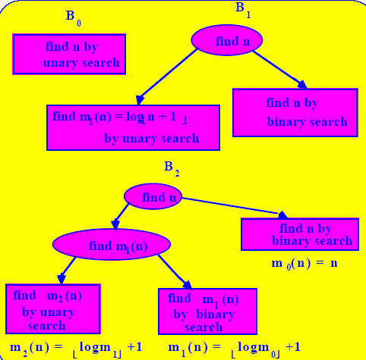
Double Unbounded Search Algorithm (cont’d)

Slide 35
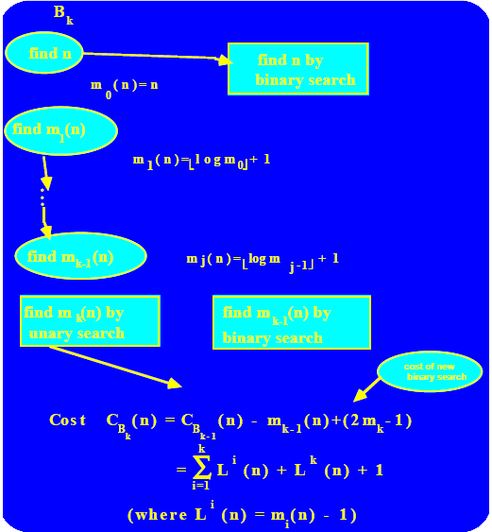
Ultimate Unbounded Search Algorithm

Slide 36
Search Algorithms
Analysis of Algorithms
Prepared by
John Reif, Ph.D.

